Slide 1
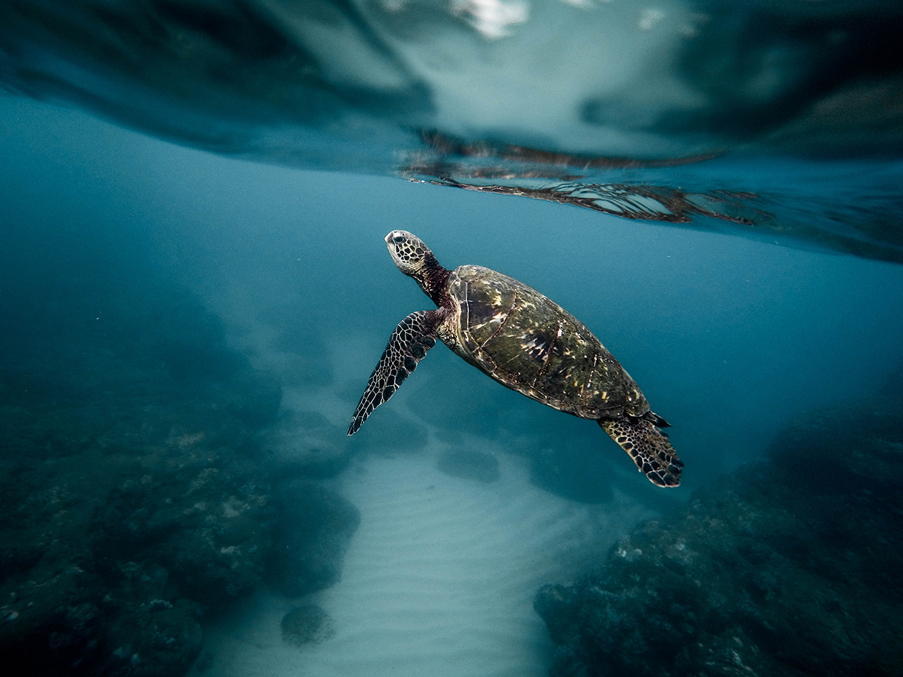
Dawn in the Cloud
Jayaprabahar

Slide 2

Agenda
Fast Forward
Sequential steps that I followed
Issues Faced
Queries
2

Slide 3
Fast forward
Created a profile in Azure portal
First pulled a git repository
Locally tested the application with Docker desktop and Docker compose tools
Then I pushed the image into ACR.
To preform that, I first created resource group and ACR
Changed the tag name of the image from MCR to my own ACR login url
Pushed the image into ACR
Created an AKS based on resource group and ACR
Using kubectl apply and k8s config file, the deployment made into AKS
Then performed some operations on AKS such as scale, enable auto cluster and all
Created a profile in Azure DevOps portal
Created repo, and committed the voting application again into this repository.
Created build and deployment pipeline and enabled trigger for automatic pipeline

Slide 4
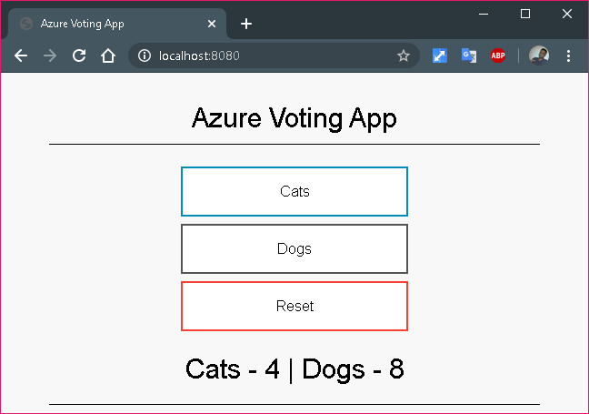
Prepared Application Locally
At the first step, I pulled and locally built the Voting application
git clone https://github.com/Azure-Samples/azure-voting-app-redis.git
$ docker-compose up -d
$ docker images
$ docker ps
$ docker-compose down (Finally cleared the local Docker container)

Slide 5
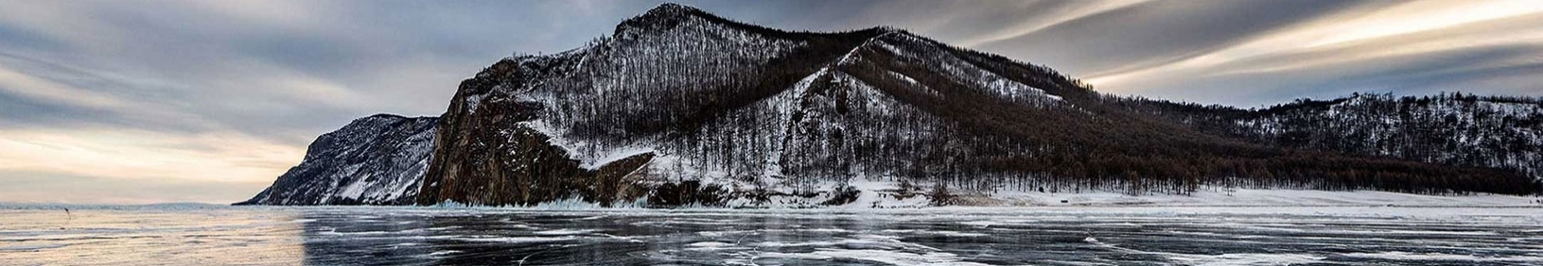
Resource Group, ACR, Location
ACR
Resource Group
Location
To deal with containers in Azure cloud, we need to store the images in Azure Cloud Registry (ACR)
A logical group in which Azure resources are deployed and managed.
When creating a resource group, need to specify a location. This location is where resource group metadata is stored, it is also where your resources run in Azure if you don't specify another region during resource creation

Slide 6
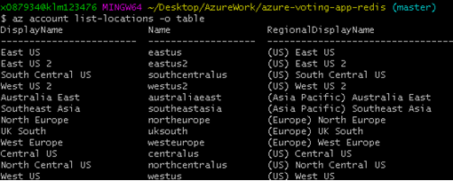
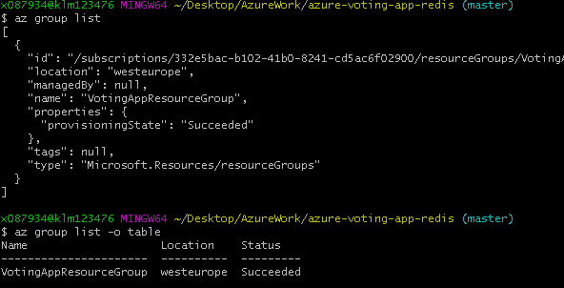
Create Resource Group
Tutorial refers East US region. I searched all the available regions and chose westeurope, which is suitable for us with less latency
Created resource group
az group create --name VotingAppResourceGroup --location westeurope

Slide 7

Create container registry
Created ACR
List ACR
Log into ACR

Slide 8

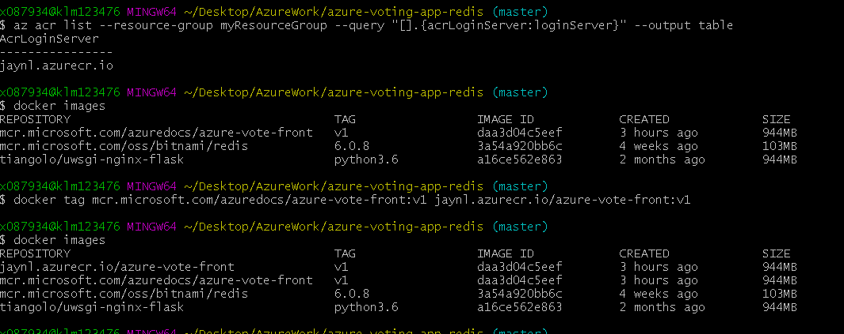

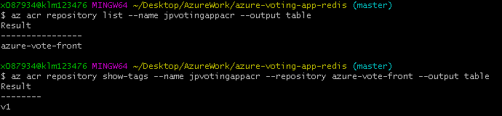
Prepare images for ACR
List local container images
Tag a container image
Push image to registry
List images in the registry
(An image is tagged with the ACR instance address & a version number)

Slide 9
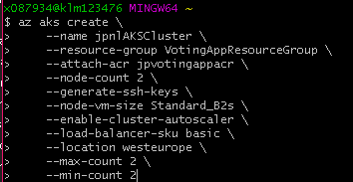
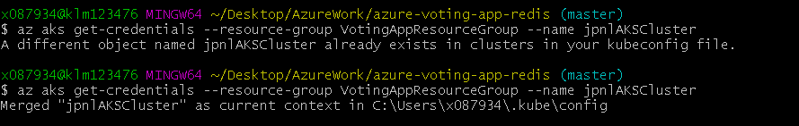
Create Azure K8s Cluster
Created AKS cluster, asper the requirement
Referred B-Series VM from following page https://azure.microsoft.com/hu-hu/blog/introducing-burstable-vm-support-in-aks/
Ensured 2 nodes are created
Now tried to connect to AKS with my local kubectl tool. Got successed after overriding my local kubeconfig

Slide 10
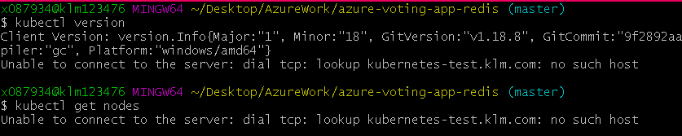
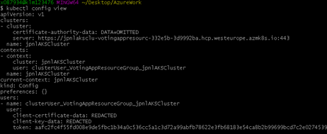

Kubectl preparation for AKS
Now tried to connect to AKS with my local kubectl tool. Got successed after overriding my local kubeconfig
Once merged, check the kubeconfig

Slide 11
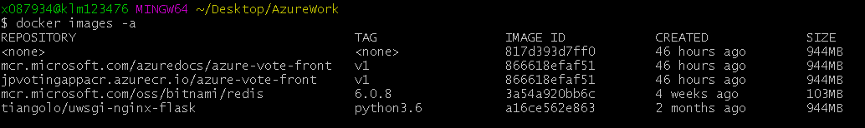
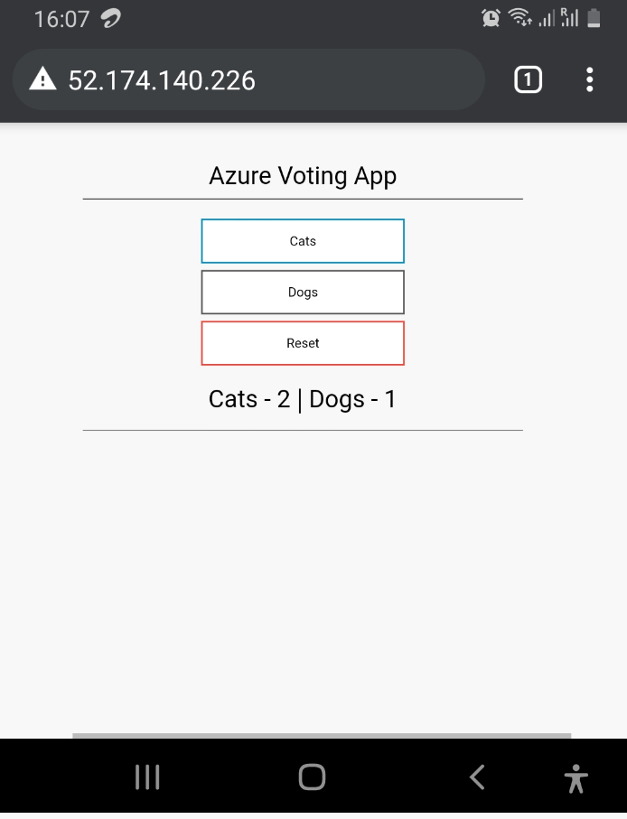
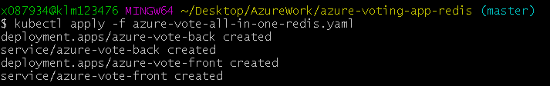

Run application in AKS
ACR has the container image for the application.
The k8s yaml file (deployment) retrieves image from Microsoft mcr, which must be updated to our own Azure’s ACR.
Find ACR login server detail
Perform kubectl apply command to push the change
Following command provides monitoring and exposes the external IP address where the application hosted
Now you will see the application running with the dedicated IP

Slide 12
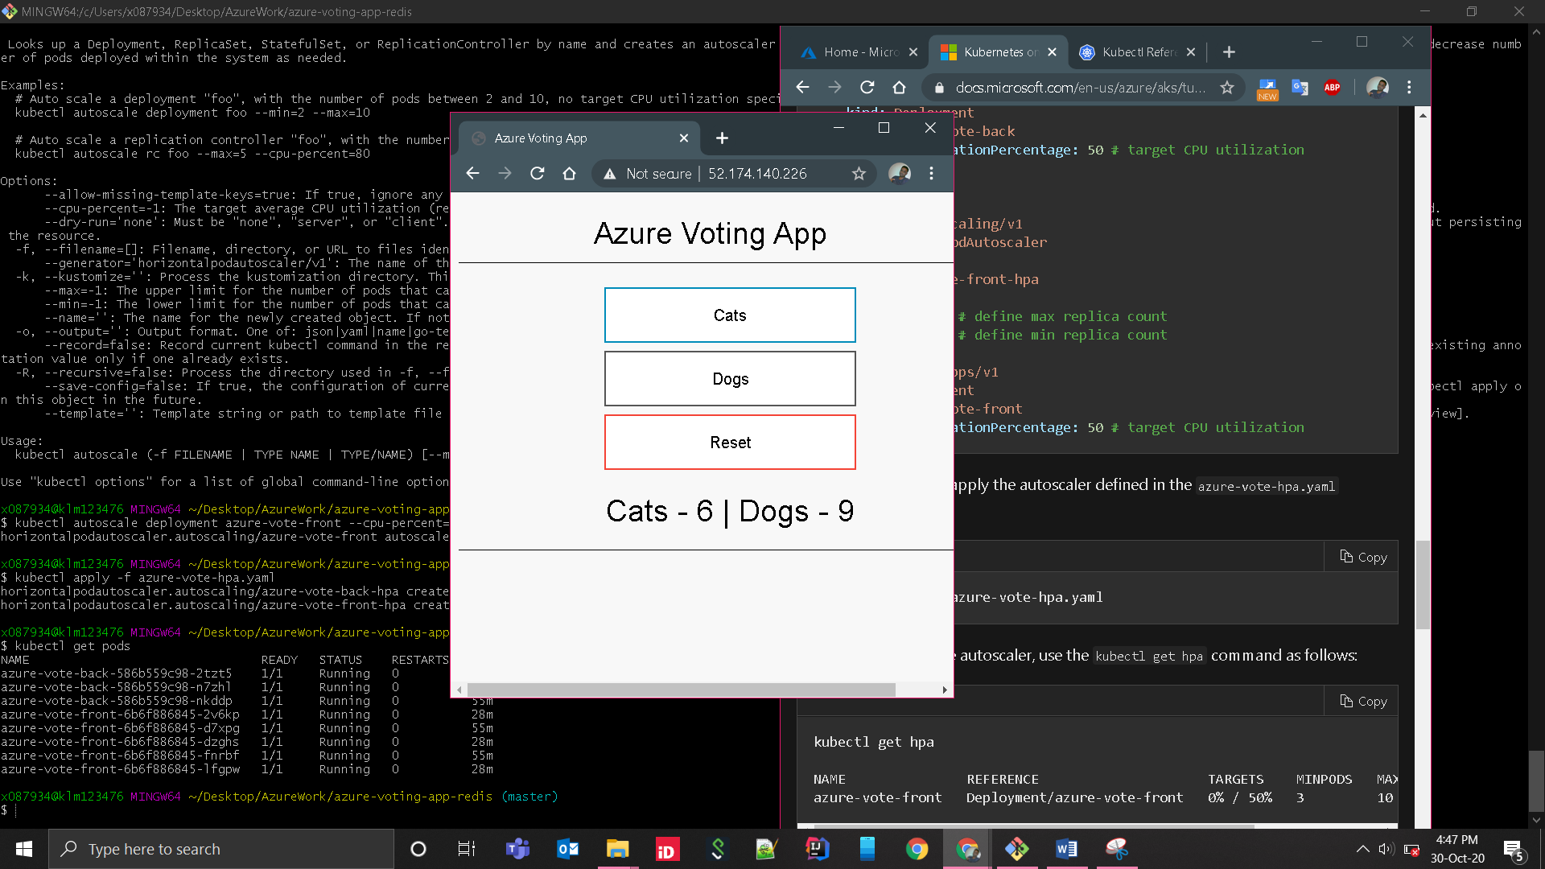
Scale & Auto Scale
K8s supports horizontal pod auto scaling. Metrics Server is used to provide resource utilization to k8s, and is automatically deployed in AKS clusters versions 1.10 and higher. So we need to verify our k8s version

Slide 13
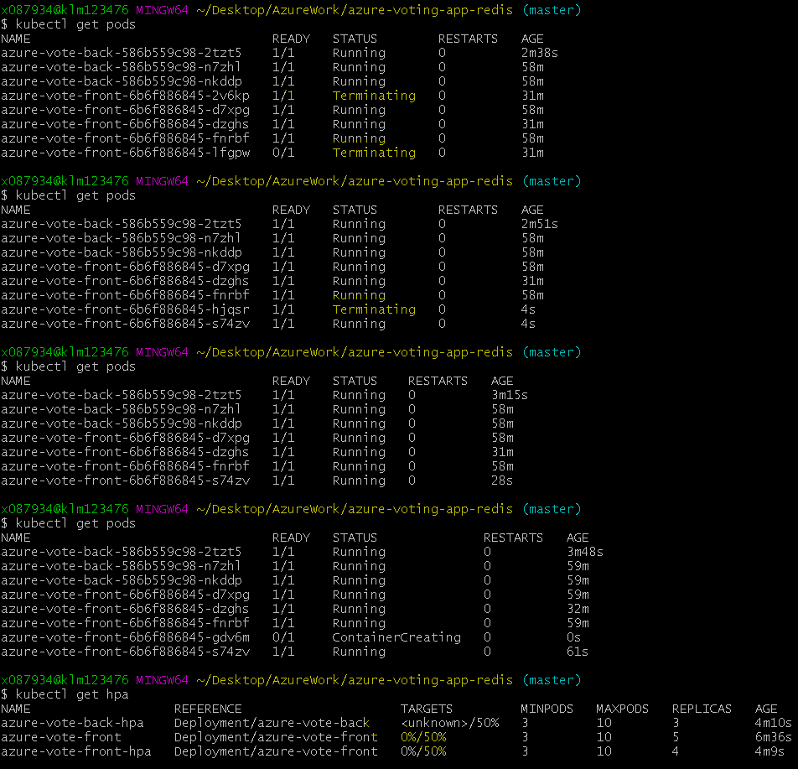
Descale
When not in use, applications are scaled down. This was set based on the CPU size. If the CPU usage goes above 50%, then it triggers new pod creation

Slide 14
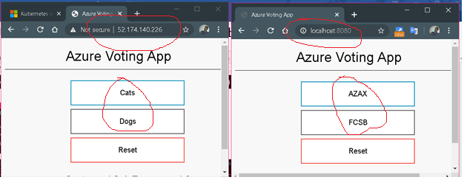
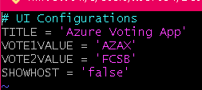
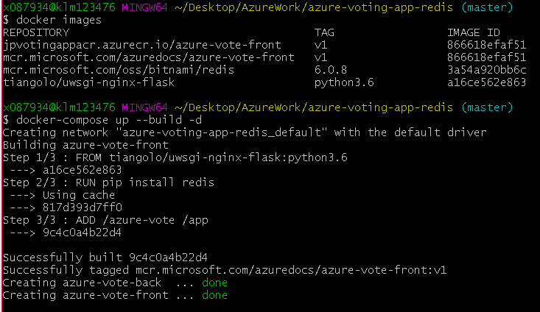
Update application & Test Locally
Perform changes
Locally build and test

Slide 15
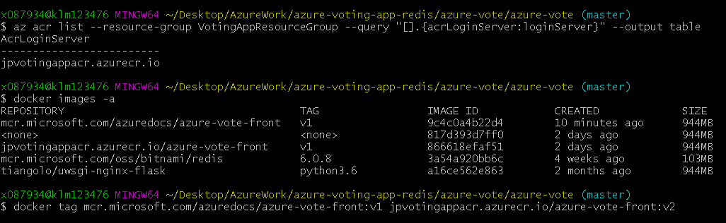
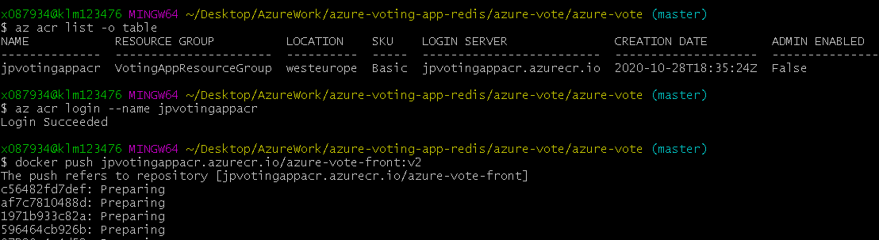
Update application in AKS
Tag the image with new version number
Push images to ACR
With k8s set new image

Slide 16
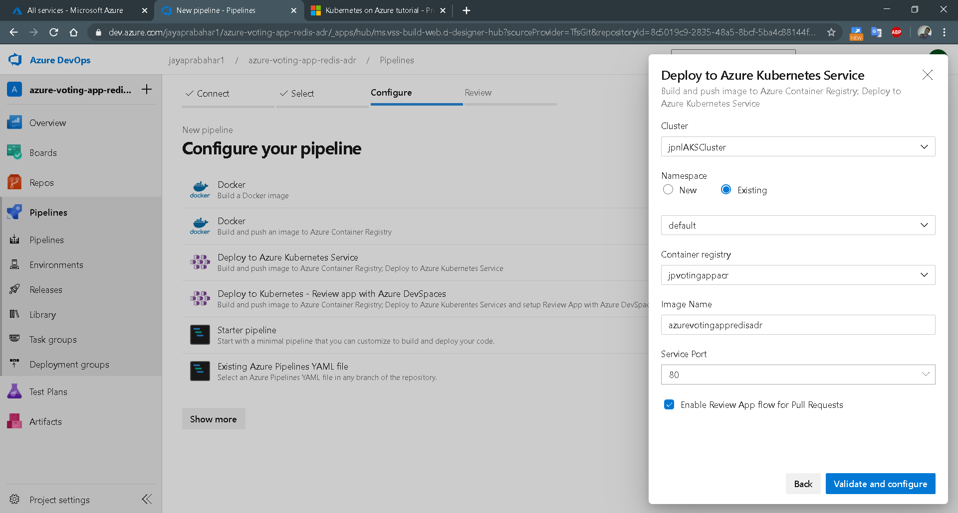
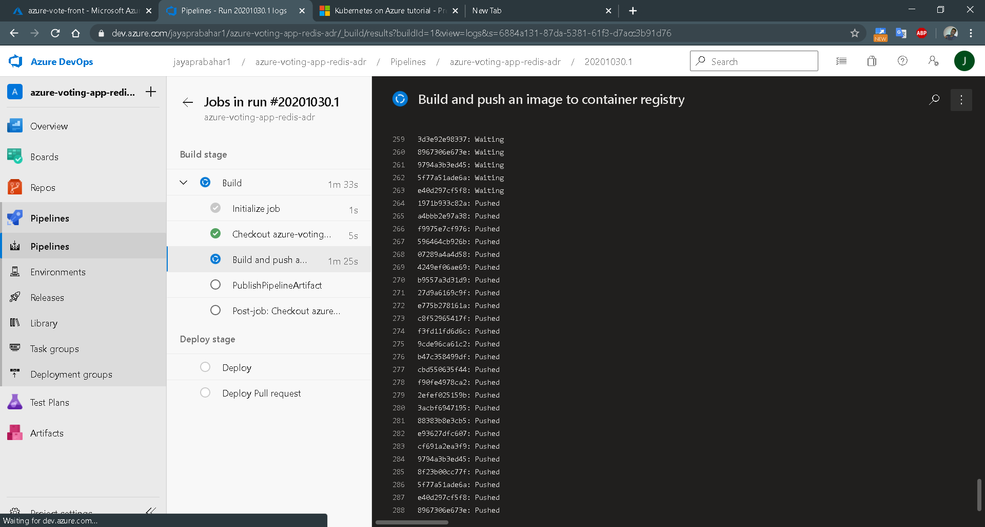
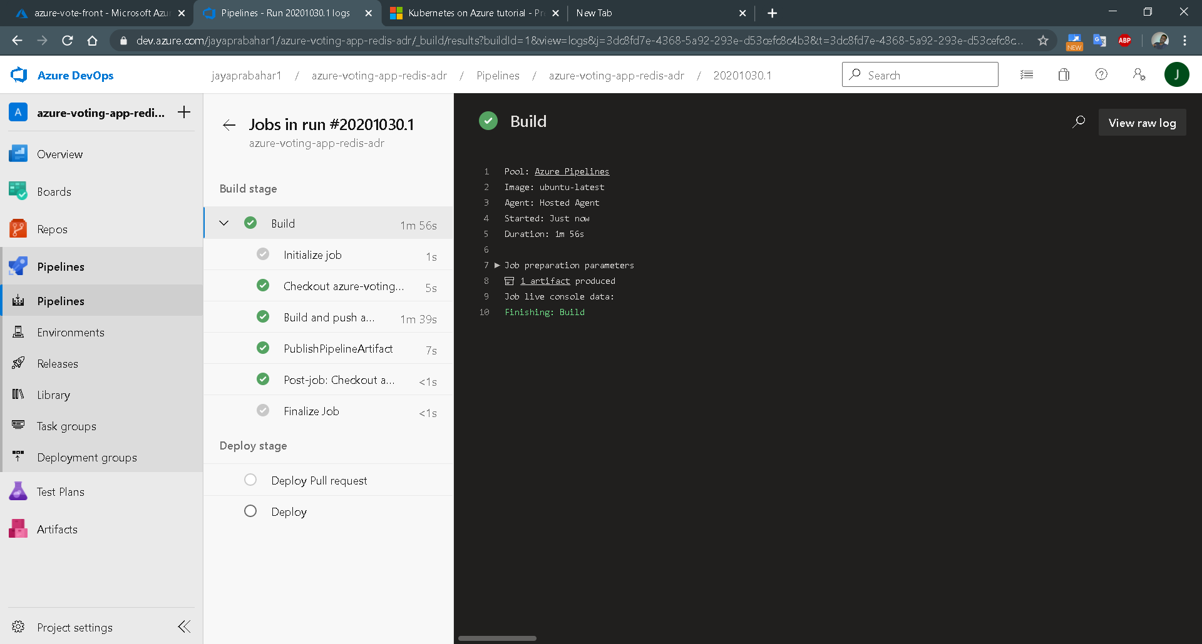
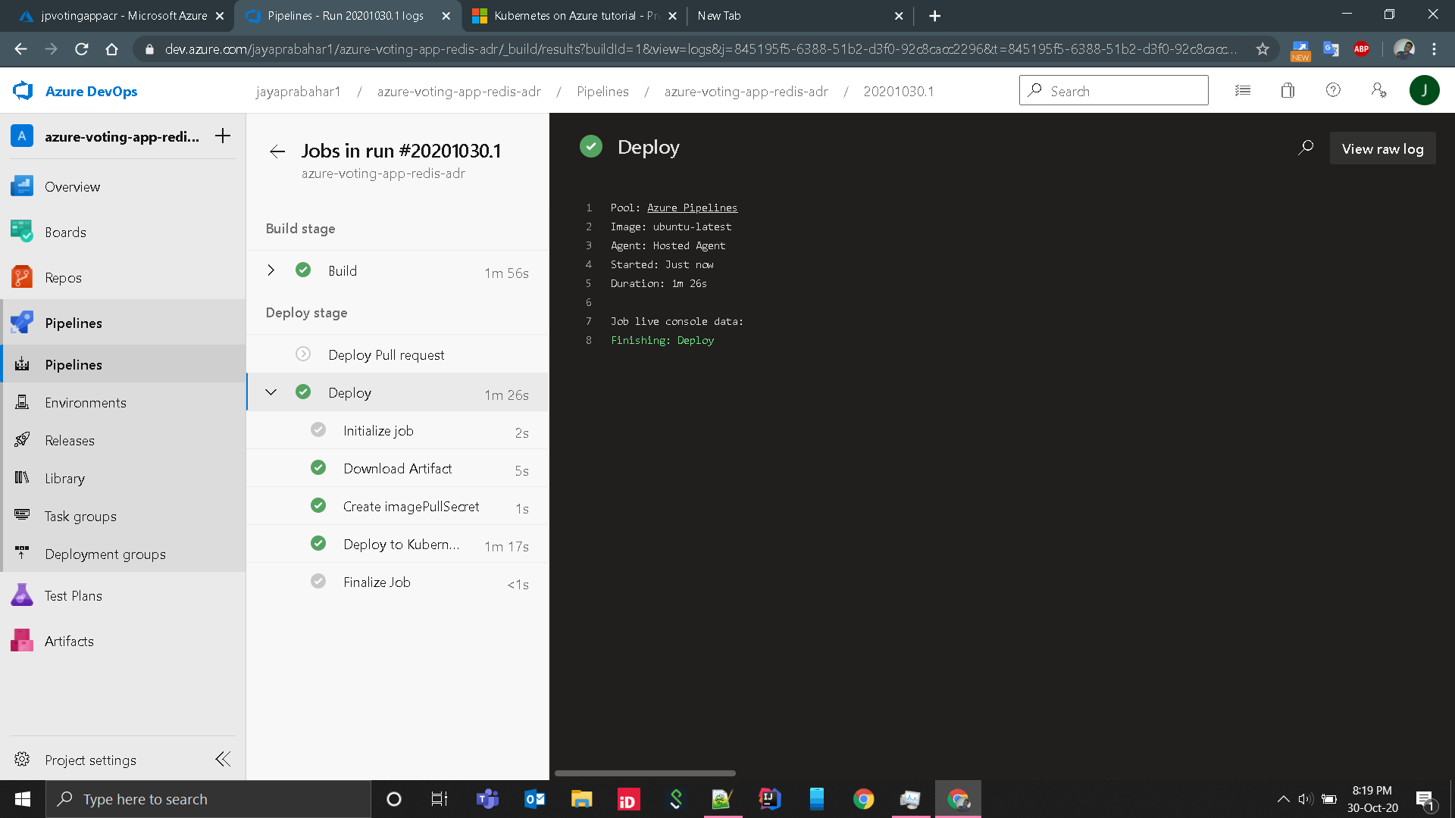
Configured Azure Build Pipeline

Slide 17
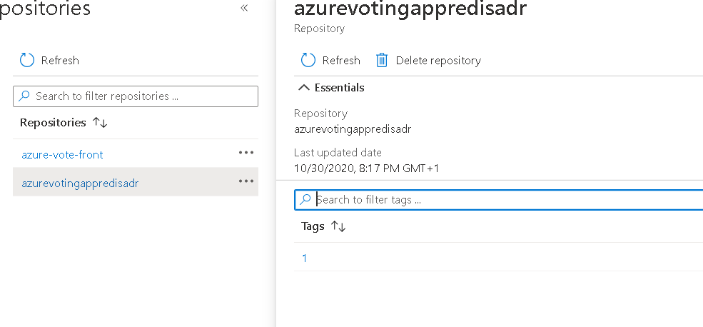
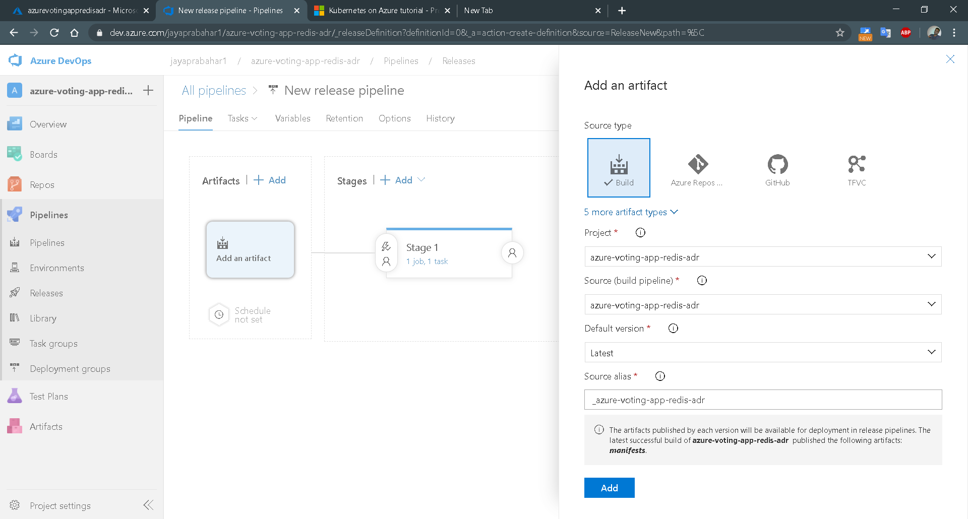
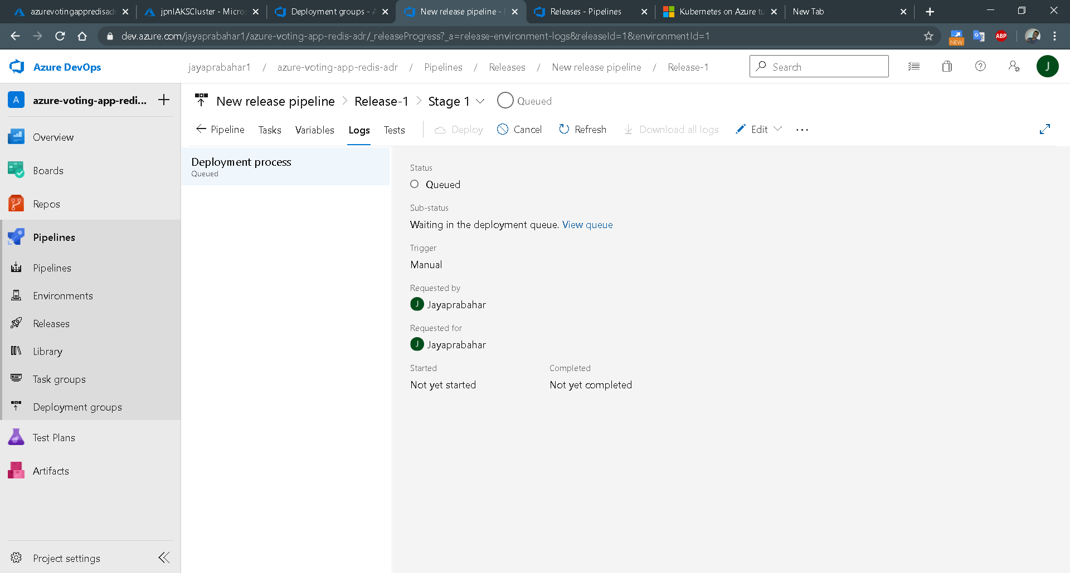
Configured Azure Deployment Pipeline

Slide 18
Correcting azure generated pipeline configurations
When pipeline is created via azure devops, it will create
azure-pipelines.yml
Mainifest folder with deployment.yml and service.yml
This deployment and service.yml file refers only the front-end app. There is no configuration for backend app, i.e., redis. Also few more configurations such as acr repository location is not properly set.
So even though initial deployments success, it wont expose the application.
So we need to update the pipeline reference to refer our own k8s config file.
Copy manifests/azure-vote-all-in-one-redis.yaml to manifests folder
Correct the image location from where we need to pull acr image into aks.
Once these changes are done, then deployment is smooth.
NOW FULL CI CD is implemented ☺ !!!!

Slide 19
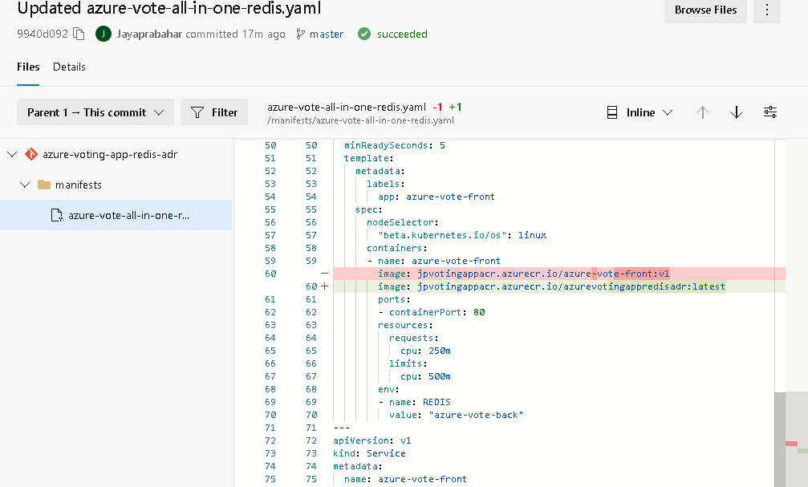
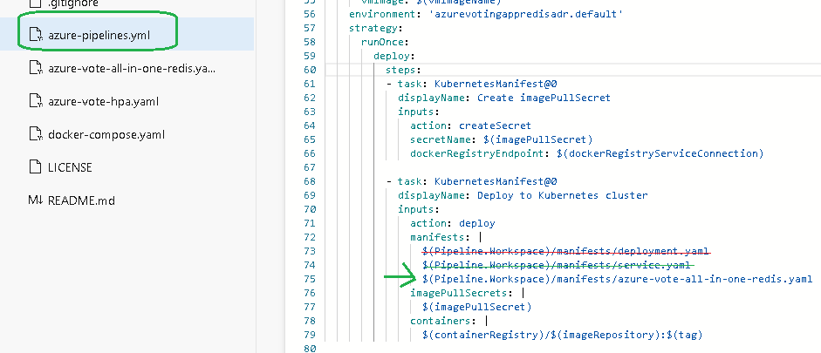
Correcting azure generated pipeline configurations

Slide 20
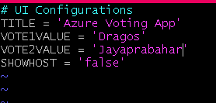
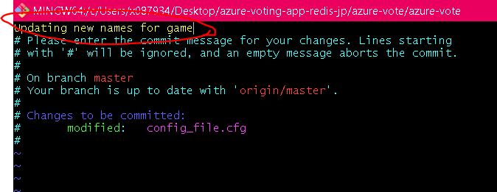
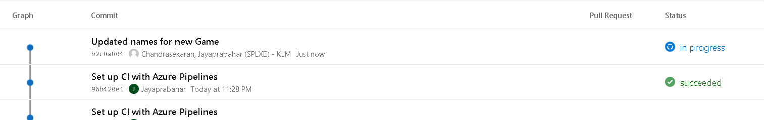
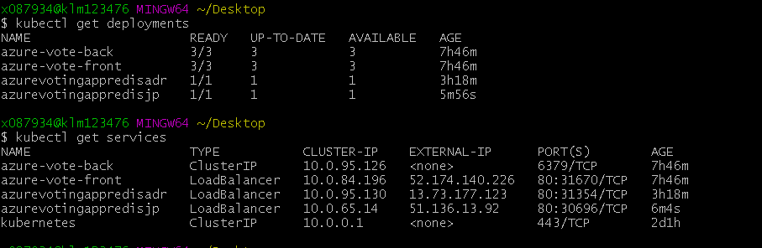
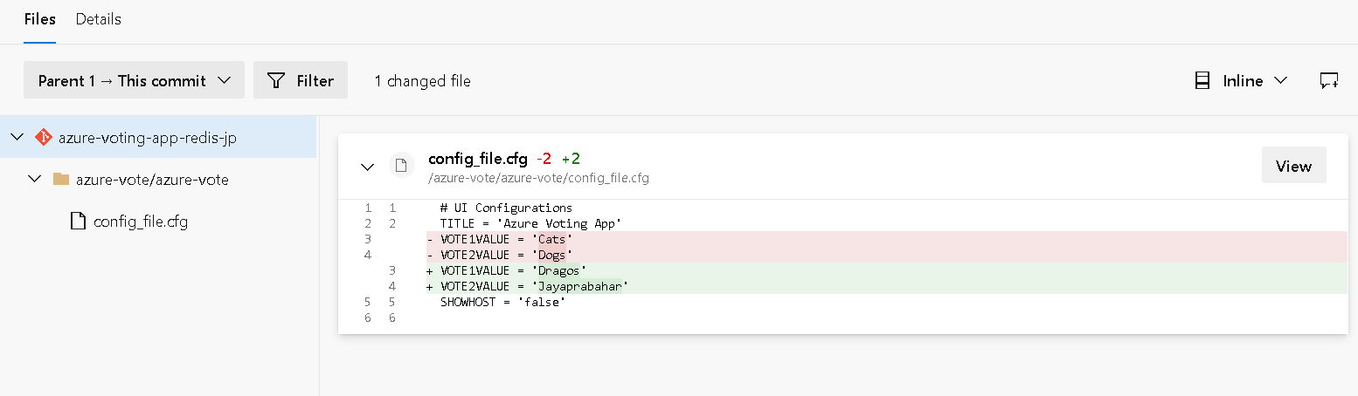
Automatically Trigger Pipeline on Code Commit

Slide 21
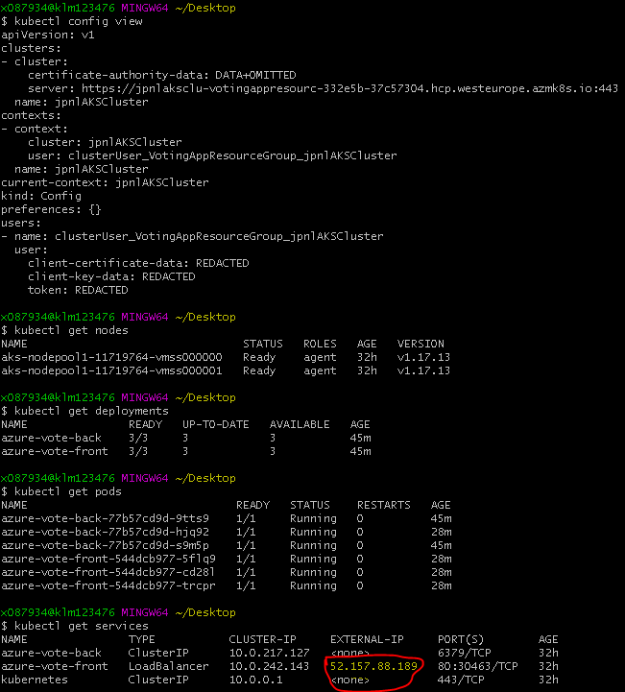
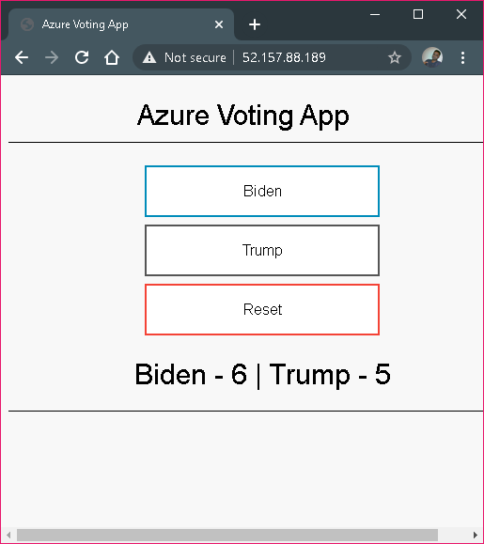
Kubectl configurations

Slide 22
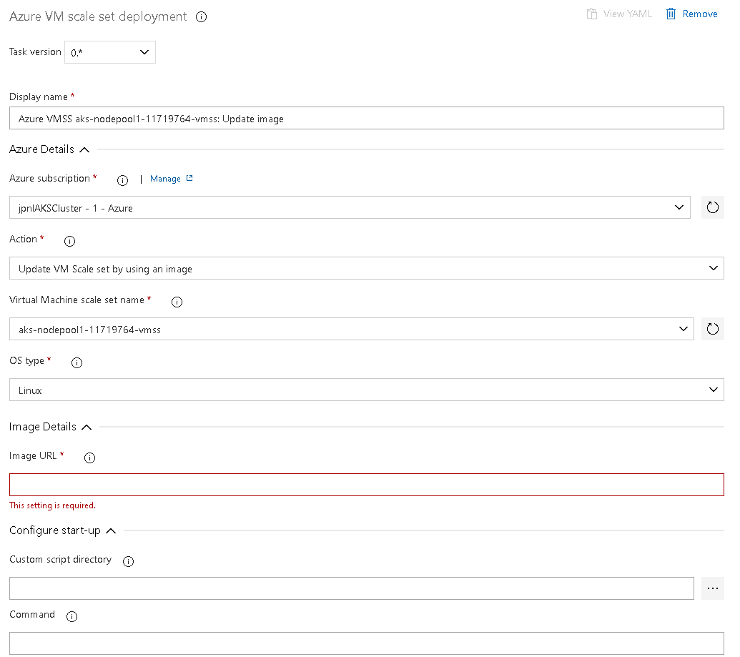
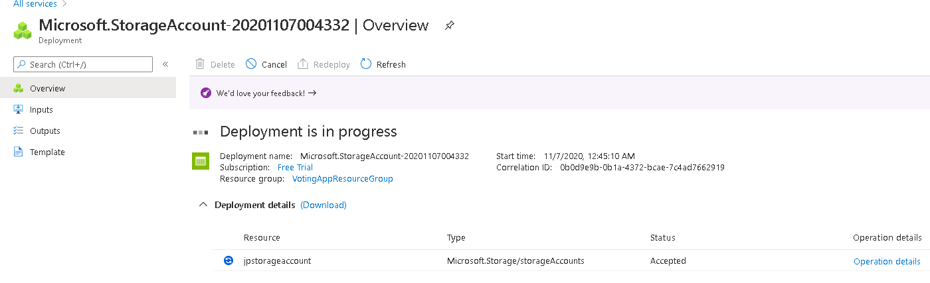
Create pipelines for start and stop the VM scaleset
First I added plugin from marketplace for Azure VM manager
To create pipeline for start and stop the VM scaleset, I need to have VM scale set.
Previously I also created storage account.
However I am not sure, how to get the image url.

Slide 23
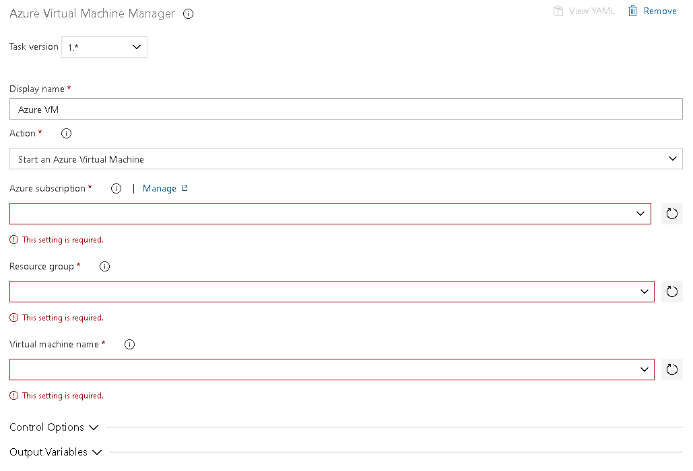
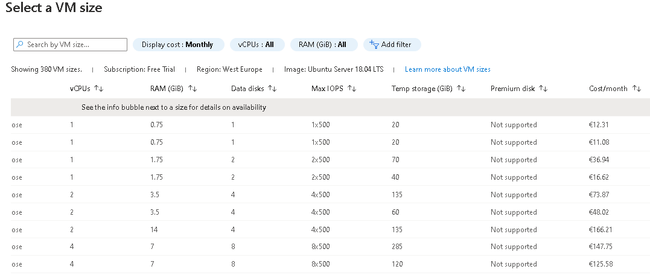
Create pipelines for start and stop the VMs
I also tried to create pipeline to start and stop VMs.
But I am not able to add new VMs for free

Slide 24
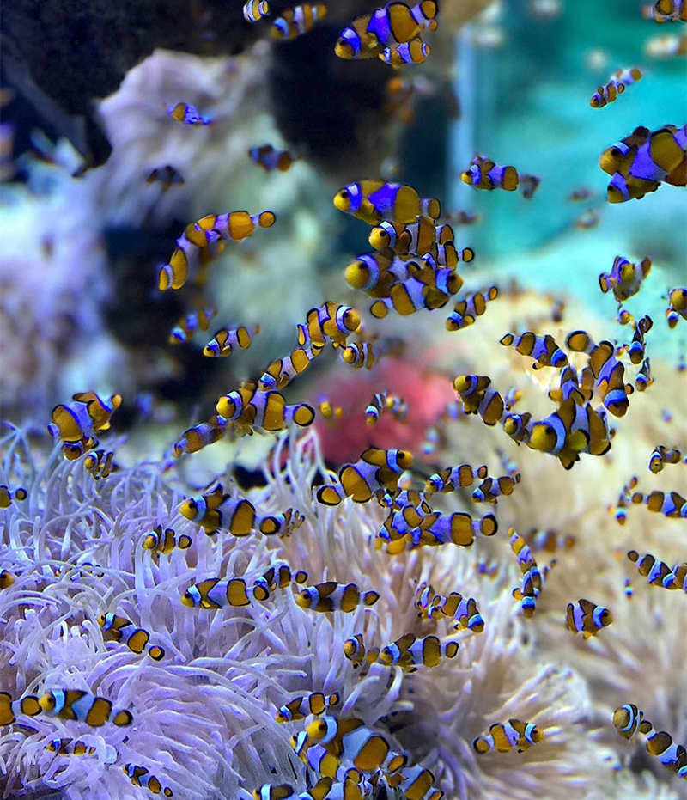
Issues Faced - 1
When creating AKS, it didn't allow names with "-" separator
When creating ACR, it warns that I shouldn't use capital letters, because they are considered as small cases.
Image push was taking long time, and it started handing. So killed the process and on return I saw image was already pushed
As per the tutorial, I needed to use "--enable-cluster-autoscaler“. That mandated me to use "max-count 2 --min-count 2“
It took some time for me to find how to create Bseries 2 size VM. Then i read the following page https://azure.microsoft.com/hu-hu/blog/introducing-burstable-vm-support-in-aks/
When dealing with kubectl for the first-time with AKS, I had many issues. Aks get-credentials did not solve the issue. Then later I found that, I set kubeconfig value in environment variable. So I removed and forced kubectl to use the one in the user firectory/.kube folder
During docker image push, I got authentication error. So I performed az acr login
24

Slide 25
Issues Faced - 2
When deploying v2 app, kubectl set image command took very long time. I performed some kubeclt operation to restart or rescale, then kubectl started working as usual
When creating Azure DevOps id, my outlook password didn't work. I have generate one from the DevOps portal. Seems this is an expected behavior
As kubectl command was hanging more often, I stopped the AKS. It took so much time and effort to start the AKS again, as I need to go through different steps to ensure that it is started finally. Eg:- Disabled autoscaler,
Unable to update the kubernets
Please refer “Correcting azure generated pipeline configurations” slide for some issues faced and solved during “Configuring CI-CD pipeline”
25

Slide 26
Queries
When not using the cluster stop the Virtual machine scale set to save on costs. ??
The applications created using DevOps pipeline is not working on external IP
When pods are scaled using horizontalAutoscale yaml configurations, I noticed that the data is not in sync across the pods. Means for every refresh of the page, I got different values. Means I got for Cat-DOG, once 23-24 and 6-9.
More often kubectl commands was hanging, not sure why
Not able to upgrade the k8s version from 17 to 18.
26

Slide 27
Queries
Scale operation did not work after sometime
$ az aks scale --name jpnlAKSCluster --resource-group VotingAppResourceGroup --node-count 3
BadRequestError: Operation failed with status: 'Bad Request'. Details: Provisioning of resource(s) for container service jpnlAKSCluster in resource group VotingAppResourceGroup failed. Message: Operation could not be completed as it results in exceeding approved Total Regional Cores quota. Additional details - Deployment Model: Resource Manager, Location: westeurope, Current Limit: 4, Current Usage: 2, Additional Required: 4, (Minimum) New Limit Required: 6. Submit a request for Quota increase at https://aka.ms/ProdportalCRP/?#create/Microsoft.Support/Parameters/%7B%22subId%22:%22332e5bac-b102-41b0-8241-cd5ac6f02900%22,%22pesId%22:%2206bfd9d3-516b-d5c6-5802-169c800dec89%22,%22supportTopicId%22:%22e12e3d1d-7fa0-af33-c6d0-3c50df9658a3%22%7D by specifying parameters listed in the æDetailsÆ section for deployment to succeed. Please read more about quota limits at https://docs.microsoft.com/en-us/azure/azure-supportability/regional-quota-requests..
27

Slide 28
THANK YOU
Insert Image

